Slide 1
Automate Infrastructure Deployment using Terraform
Easy Ways to Spin up Your openSUSE Machine on Linode Public Cloud Providers
M Dhenandi Putra
openSUSE ID, STMIK Bani Saleh
dhenandi@opensuse.{id,org}

Slide 2
Class Objectives
Understanding Terraform Concepts
Understanding Basic of Terraform Configuration File
1
2
< >
Understanding How to Provision your Infra using terraform
4
3
Understanding How to provision and deploy apps using terraform

Slide 3





M. Dhenandi Putra
Product Manager at https://www.excellent.co.id
Student at STMIK Bani Saleh Bekasi
Geeko Lovers!
Community Members of openSUSE & openSUSE Indonesia
  Not a code contributor
  Organizing openSUSE Translator Meetup ID
  openSUSE Asia Summit 2016 Volunteer (Yogyakarta, ID)
  openSUSE Asia Summit 2017 Speaker (Japan)
  Local Commitee for openSUSE Asia Summit 2019
dhenandi
mdhenandi

Slide 4
What is Terraform?

Slide 5
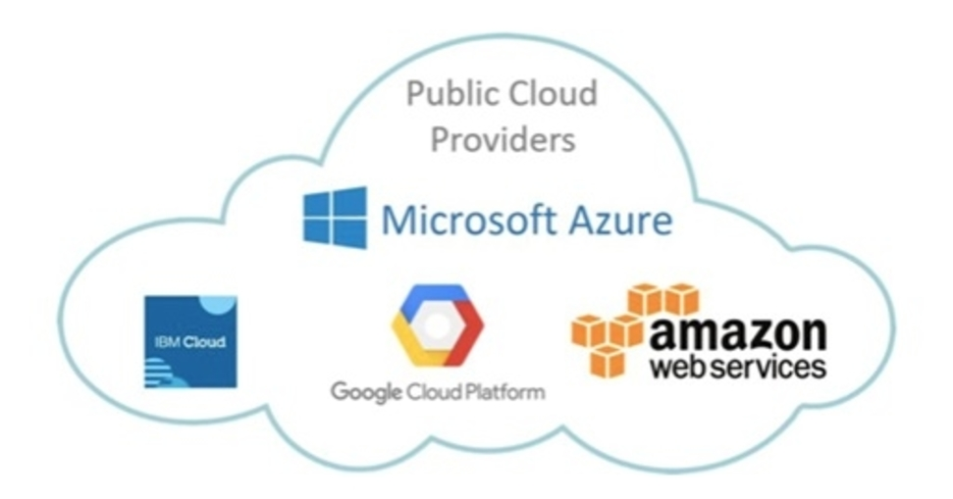
Terraform is …
A Tool to provisioning your infrastructure as a code
Just imagine you are consumer of this ...
And then you want to …
Spin up some machines/instances
Deploy an application

Slide 6



Why Terraform?
Terraform is a tool for automation your infrastructure easily
Auditable, you know what you created and changed
  You can keep change history in system versioning like Git
Keep your infrastructure in a certain state
Terraform can provision your cloud or on-premise infrastructure

Slide 7
Terraform VS Ansible, SaltStack, Chef
Terraform has a focus to provision the infrastructure
These tools has a focus to instal, configure and manage the software
Terraform communicate with provider using API
These tools communicate with the software using SSH or agent
You can use all of these tools to manage your deployment
Notes:
Recommendation if you wan to provisioning software using ansible

Slide 8

And We will collaborate Terraform with ...

Slide 9
Why Linode?
Officialy support for openSUSE Leap Cloud Images every single release!
API Support
Simple management
Powerfull

Slide 10
Before this, make sure you have ..
< >
01
02
03
Installing terraform on your PC
registered and verified Linode Account
You have internet connection

Slide 11
1. Terraform Installation
https://learn.hashicorp.com/terraform/getting-started/install.html

Slide 12
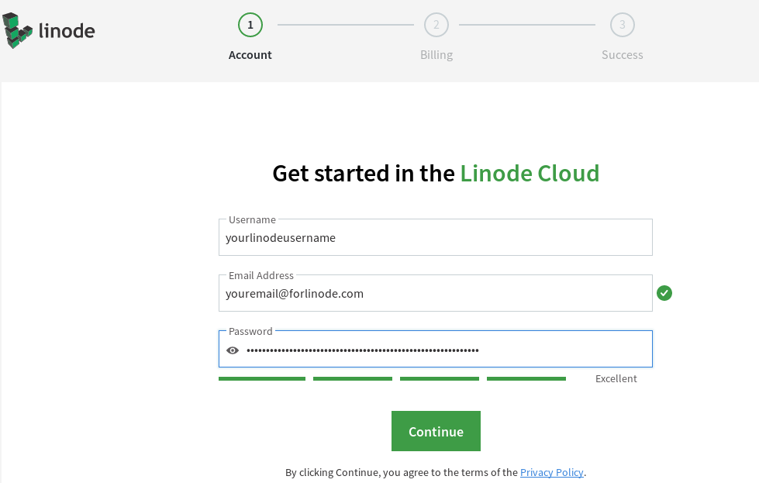
2. Registering Linode Account
Navigate to: https://login.linode.com/signup
Make sure you have a credit card (or if you are Indonesian people you can use Jenius)

Slide 13
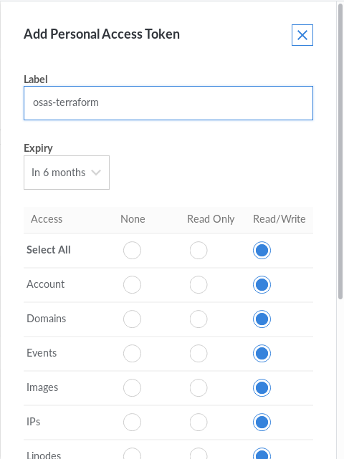
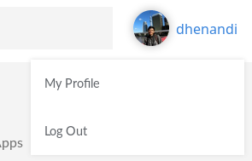
Initializing Terraform (Create an API)
Go to My Profiles | API Token | Create New API with full access

Slide 14
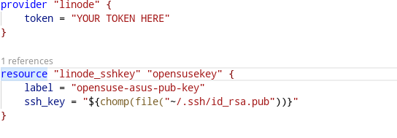
Terraform Syntax
Define the Provider
Specify the Resources

Slide 15
Let’s Hands on!
https://github.com/dhenandi/osas19-terraform

